Slide 1







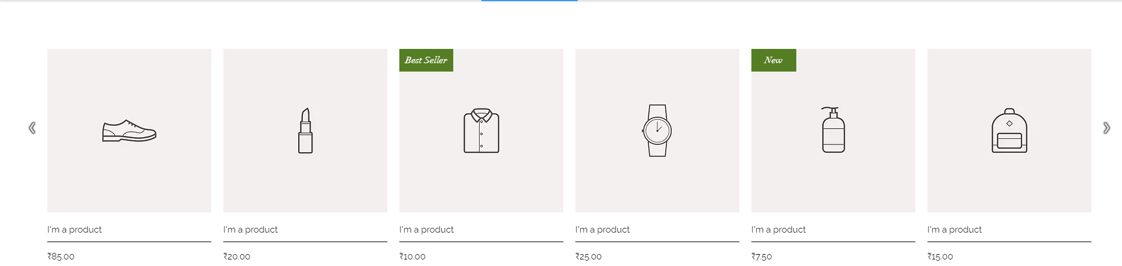
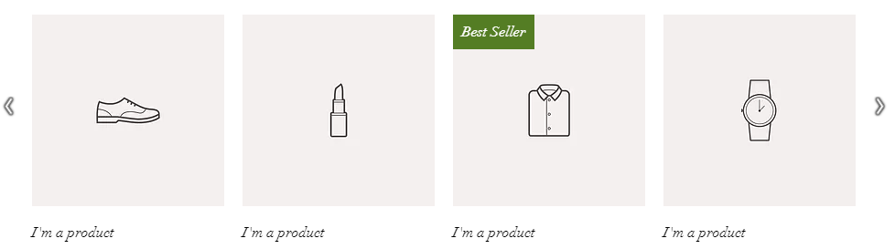

What are you scoutin for today?
Niki’s Profile
$572.30
Categories
Home Shop Caribbean Products About Us FAQs Testimonials Support
S
A
L
E
cLiCk & sAvE
$25 OFF
SWIMSUITS AT CODEX ONLY
with purchases over $500
Buy Again
THIS WEEK’S FEATURED ITEMS
Place your ad here
Things you may like

Slide 2
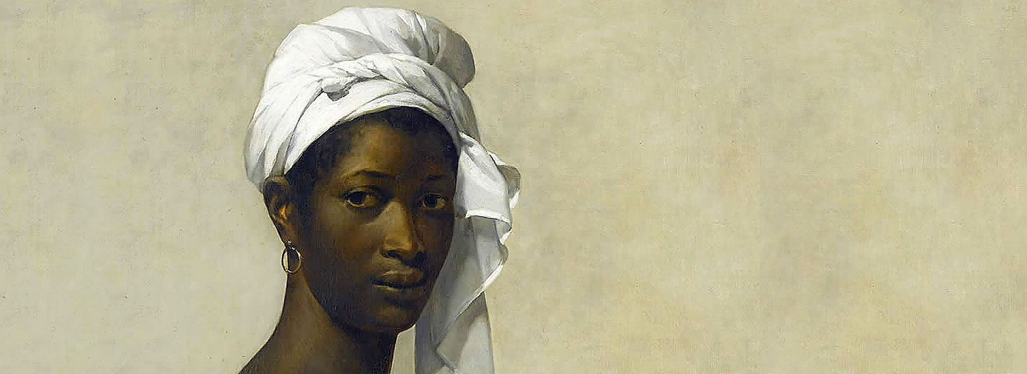

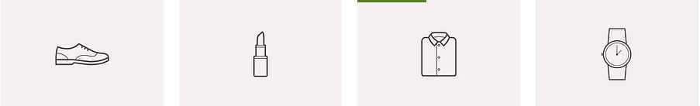


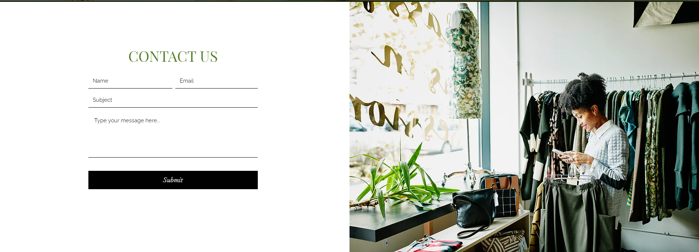
MADE IN THE CARIBBEAN
Place your ad here
Awesome finds
BE THRIFTY
Sponsored items
WHO ARE WE

Slide 3
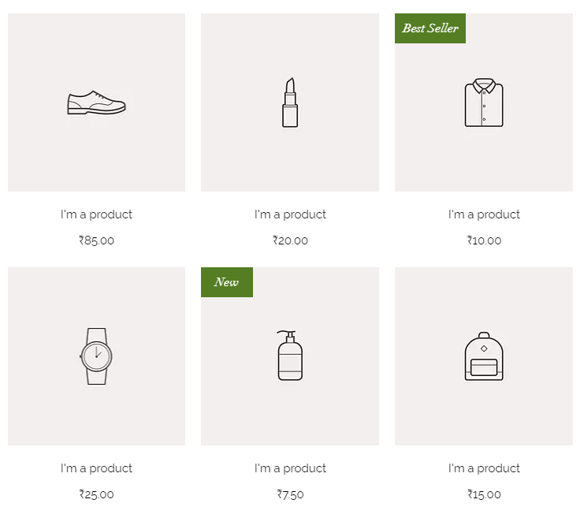

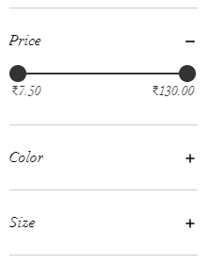
What are you scoutin for today?
Niki’s Profile
$572.30
Categories
Home Shop Caribbean Products About Us FAQs Testimonials Support
Products
Clothing
Accessories
Jewelery
Bags
Shoes
Beauty
Make up
Hair products
Garden
Pet supplies
Gourmet products
Gourmet tea
Support Local
Local designer clothing
Services
Housekeeper
Pet walker
S U P R E M E
Filter by

Slide 4

What are you scoutin for today?
Niki’s Profile
$572.30
Categories
Home Shop Caribbean Products About Us FAQs Testimonials Support
Products
Clothing
Accessories
Jewelery
Bags
Shoes
Beauty
Make up
Hair products
Garden
Support Local
Local designer clothing
S U P R E M E
Filter by
Place your ad here
Place your ad here

Slide 5
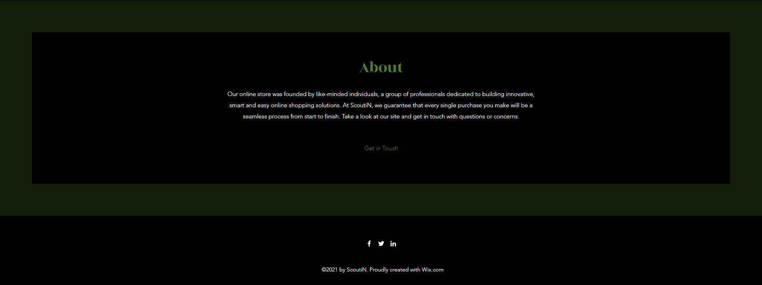
What are you scoutin for today?
Niki’s Profile
$572.30
Home Shop Caribbean Products About Us FAQs Testimonials Support

Slide 6
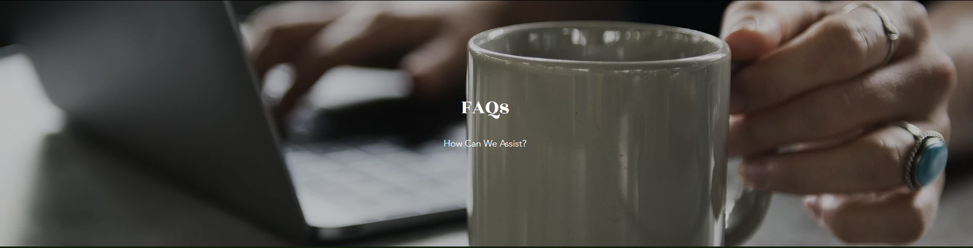
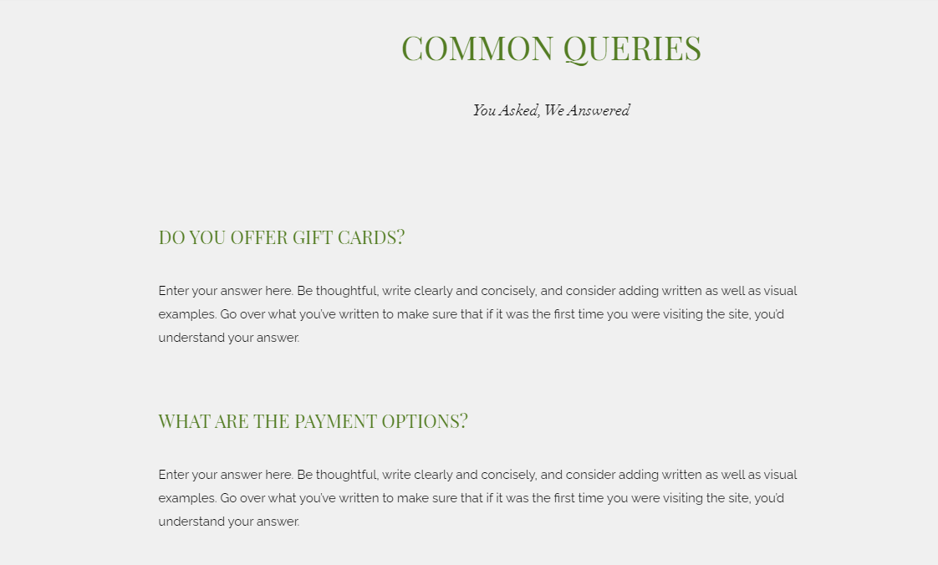
What are you scoutin for today?
Niki’s Profile
$572.30
Home Shop Caribbean Products About Us FAQs Testimonials Support

